Slide 1
Techniques of AI
Sokoban Solver
Loumaye & Balon-Perin

Slide 2
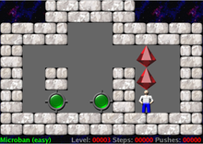
Sokoban
Puzzle video game
NP-hard
Difficulties:
searching tree depth
numbers of child nodes

Slide 3
IDA*
Space complexity (A*)
Iterative deepening depth-first search
One path at a time
Limiting cost

Slide 4
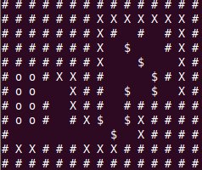
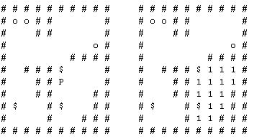
Improvement
Deadzones
Access area

Slide 5
Improvement
State repetition
Heuristic
Start costlimit

Slide 6
Conclusion
Good heuristic is hard to find
Work on small maps

